Slide 1
Engr. A. S. Oluwajembola
PROJECT MANAGEMENT FUNDAMENTALS
AUL-DHS 413

Slide 2
Common Project Management Approaches
Here, we shall discuss the common project management approaches which comprise:
Project Life Cycle
Predictive Approach
Adaptive Approach
Hybrid Approach

Slide 3
Project Life Cycle
The project life cycle is the series of phases that a project passes through from its start to its completion.
There are four phases of the project life cycle:
i. Starting the Project
ii. Organising and Preparing
iii. Carrying out the work
iv. Ending the Project – see the figure below.

Slide 4
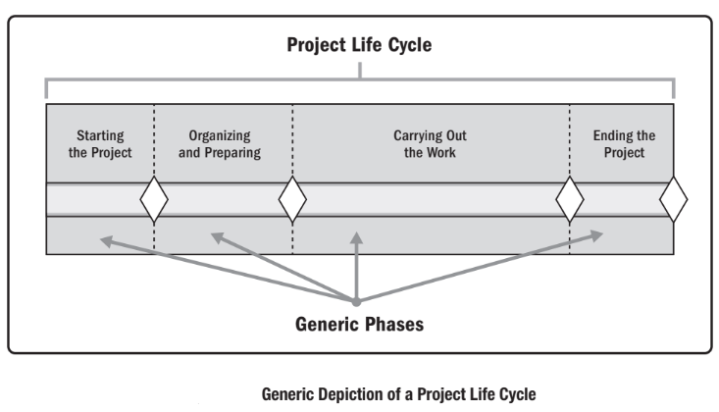
Project Life Cycle
.

Slide 5
Project Life Cycle –Starting The Project
Initiate or launch the product
The project sponsor creates the project charter
  Key Points About A project Sponsor
    Originator of the project idea
    Provides Equity Investment
    Critical Role in Securing Finance
    Risk Management Responsibility
    Ongoing Involvement

Slide 6
Project Life Cycle –Starting The Project
The project charter defines what is to be done to meet the requirements of project customers.
The charter should be used to authorize work on the project:
- define the authority,
- responsibility, and
- accountability of the project team; and
- establish scope boundaries for the job.

Slide 7
Project Life Cycle – Organising and Preparing
This is the planning phase which involves:
Identify scope
Identify tasks, dependencies and schedules
Plan resources
Clarify trade-offs and decision making principle
Develop a risk management plan

Slide 8
Project Life Cycle – Carrying out the work
This is the execution phase which also refers to implementing the project plan.
Monitor progress
Communicate and report
Correct and control

Slide 9
Project Life Cycle – Ending the Project
This is the closing phase of the project:
Sign off
Conduct a formal post-mortem
A final lessons-learned review should be done before the project is considered complete

Slide 10
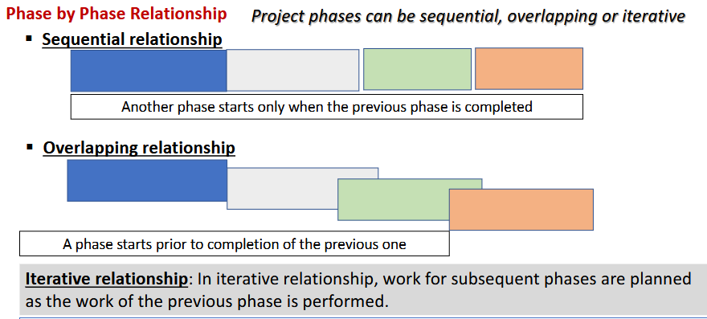
Project Life Cycle Phase by Phase Relationship
.

Slide 11
Life Cycle Selection
Project comes in several ways and there are diverse ways to handle them.
Project teams need awareness of the characteristics and options available to select the approach most likely to be successful for the situation

Slide 12
Life Cycle Selection
The PM practice guide refers to four types of life cycles:
Predictive Life Cycle: This is a more traditional approach, with the bulk of planning occurring upfront, then executing in a single pass; a sequential process.
Iterative life cycle: An approach that allows feedback for unfinished work to improve and modify that work

Slide 13
Life Cycle Selection
Incremental life cycle: An approach that provides finished deliverables that the customer may be able to use immediately.
Agile life cycle. An approach that is both iterative and incremental to refine work items and deliver frequently.

Slide 14
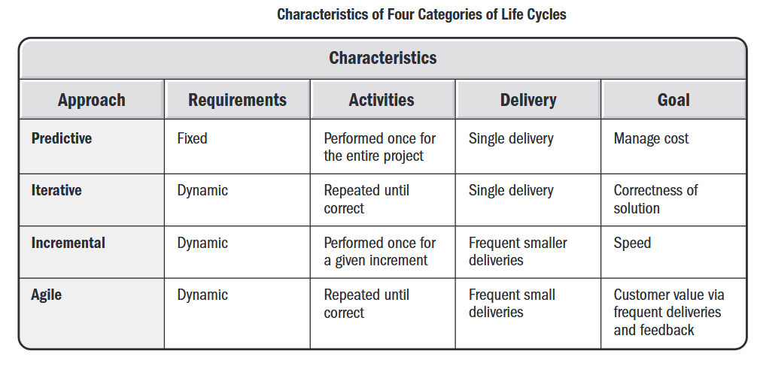
Characteristics of Project Life Cycles
.

Slide 15
Characteristics of Predictive Life Cycles
See page 791/829

Slide 16
Predictive Approach
Sign off
Conduct a formal post-mortem
A final lessons-learned review should be done before the project is considered complete.

Slide 17
. Comparison of Predictive, Adaptive, and Hybrid Project Approaches
Approach | Description | Advantages | Disadvantages
Predictive (Waterfall) | Follows a structured, sequential process with predefined phases. | Clear scope, well-defined deliverables, and easier resource management. | Limited flexibility and difficulty in accommodating changes.
Adaptive (Agile) | Iterative and flexible, allowing for continuous improvements based on feedback. | High adaptability, faster delivery, and better stakeholder collaboration. | Requires strong team collaboration and may face scope creep.
Hybrid | Combines elements of predictive and adaptive approaches to balance structure and flexibility. | Allows for structured planning while incorporating adaptability. | Can be complex to manage and requires careful coordination.

